Slide 1
Discussed and agreed: April 2017
To be reviewed: April 2018
Mary Hare Primary
Maths Calculation Policy

Slide 8
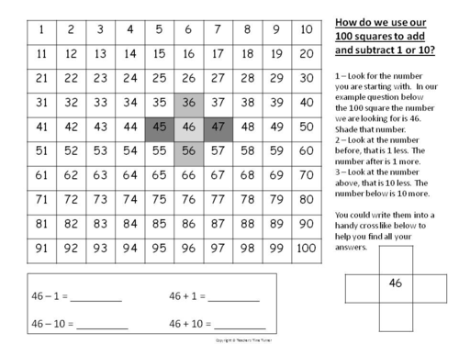
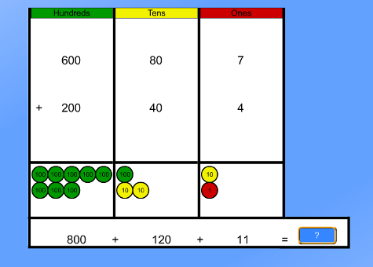
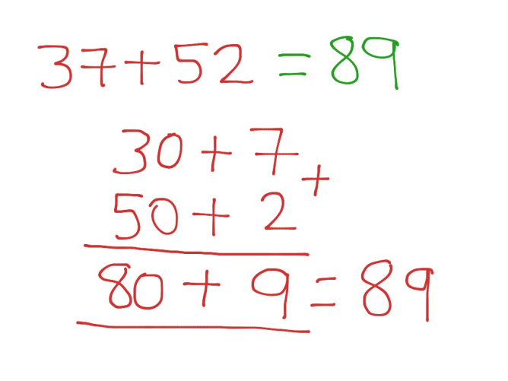
Use a 100 square to add 1 and 10. Use Arrow Cards to add 1 and 10.
Expanded Column method

Slide 10
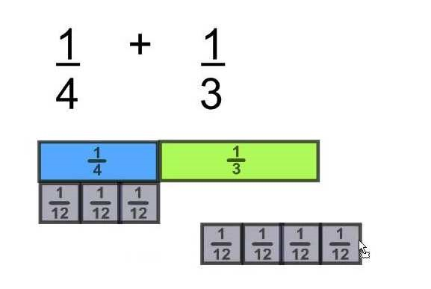
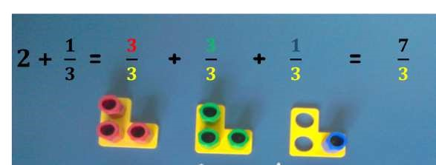
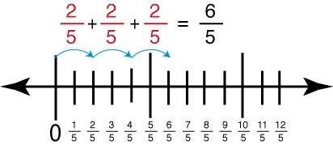
Add fractions
1
+
1
=
4
3
Count in fraction
1
x3
+
1x4
steps using real
4
x3 3x4
objects and a
number line.
3
+
4
=
7
12
12
Use the bar
12
model to add
fractions.
Use Numicon
to add
fractions.

Slide 11
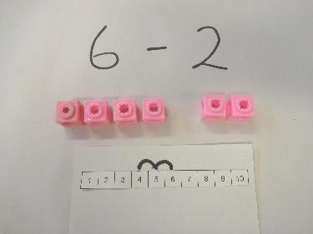

Slide 12
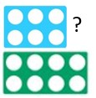

Slide 13
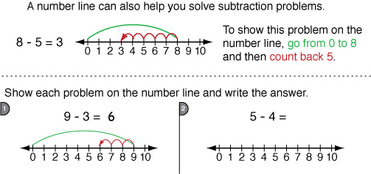
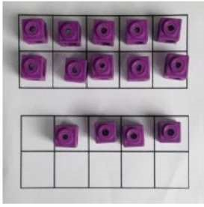
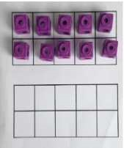
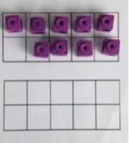
Subtracting 1 and 10 using a 100 square
Subtracting 10 and 1 on a numberline Numbered Marked Blank
Make 10 | 14 – 5 = Make 14 on the ten frame. Take away the four first to make 10 and then takeaway one more so you have taken away 5. You are left with the answer of 9. | Start at 13. Take away 3 to reach 10. Then take away the remaining 4 so you have taken away 7 altogether. You have reached your answer. | 16 – 8 = How many do we take off to reach the next 10? How many do we have left to take off?

Slide 14
Use of Expanded method required prior to formal method.

Slide 18
3 x 4 or 3 lots of 4
Children to represent the practical resources in a picture e.g.
XX XX XX
XX XX XX
Use of a bar model for a more structured method

Slide 19
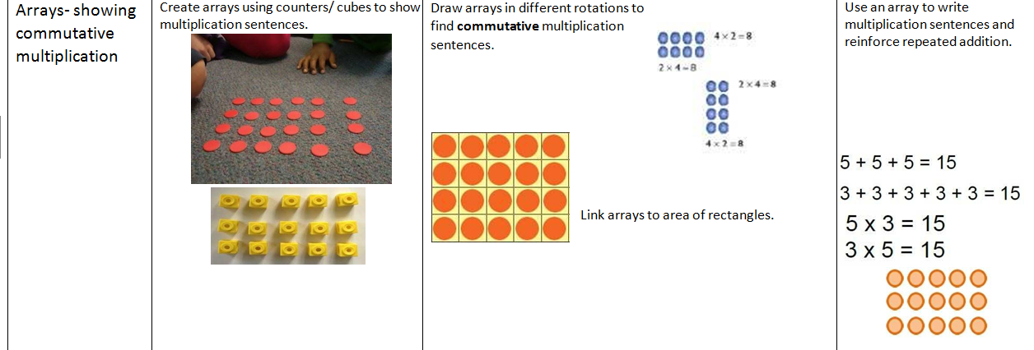
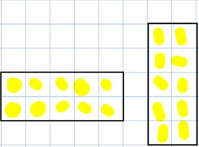
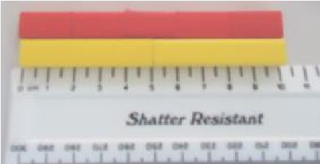
2 x 5 = 5 x 2
Children to draw the arrays

Slide 22
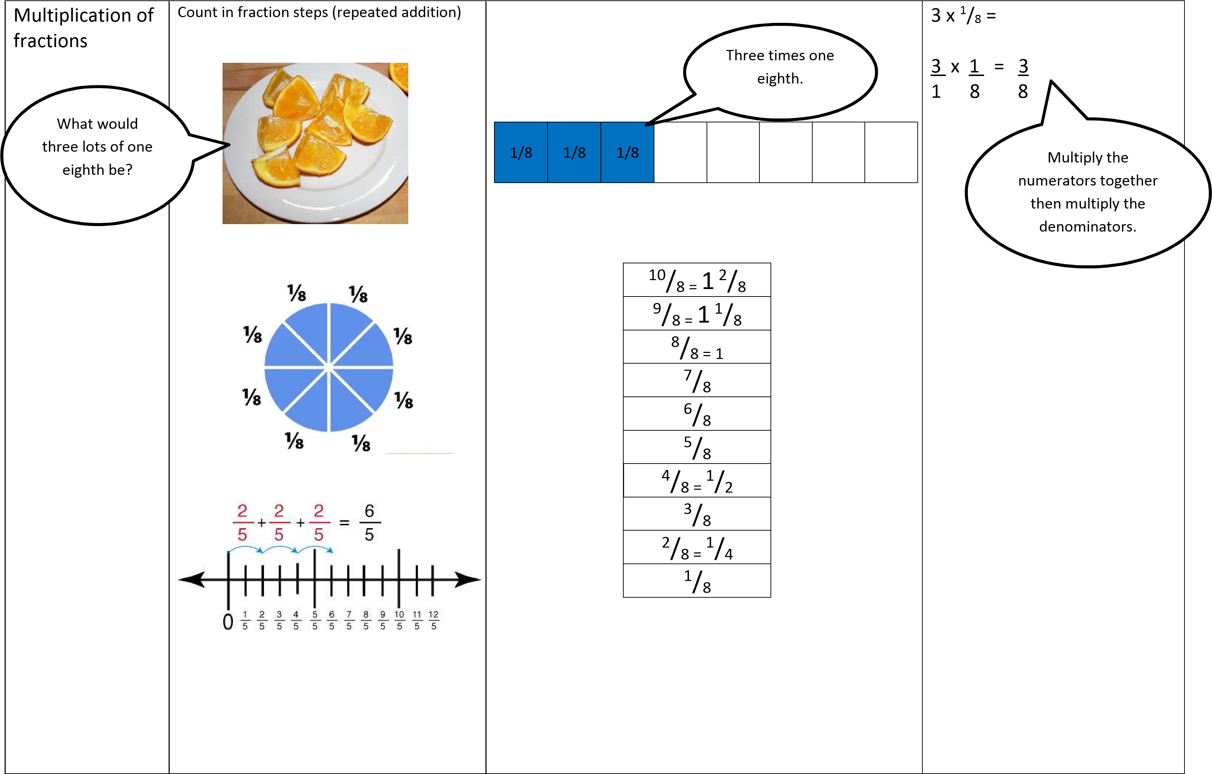

Slide 26
Long division

